Slide 1
Game Development Seminar
group 01: Stunts 2005

Slide 2
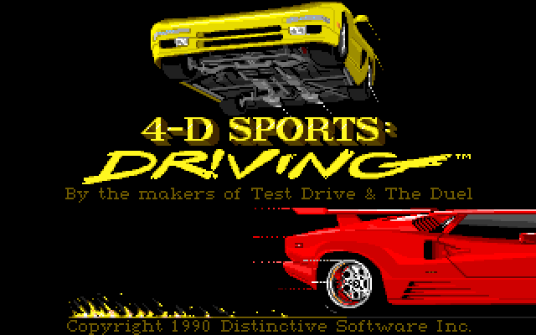
Stunts 1990
15 years old, but:
a lot of fun!

Slide 3
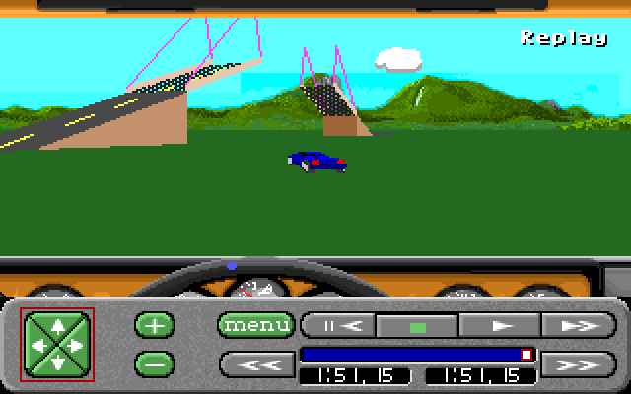
Stunts 1990
15 years old but:
a lot of fun!
realtime 3D graphics

Slide 4
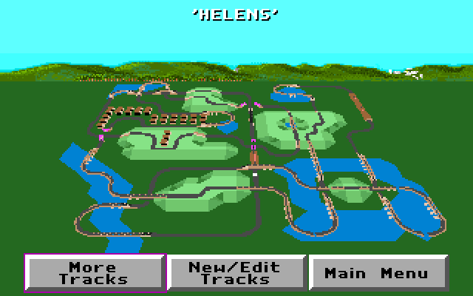
Stunts 1990
15 years old but:
a lot of fun!
realtime 3D graphics
integrated map editor

Slide 5
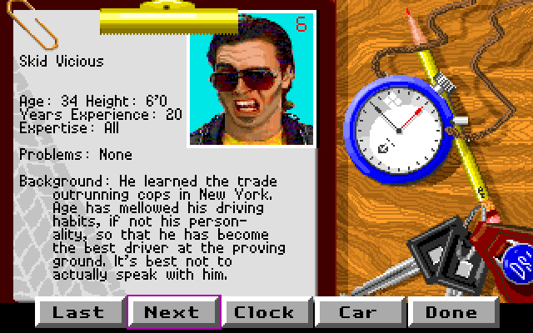
Stunts 1990
15 years old but:
a lot of fun!
realtime 3D graphics
integrated map editor
nice artificial intelligence

Slide 6
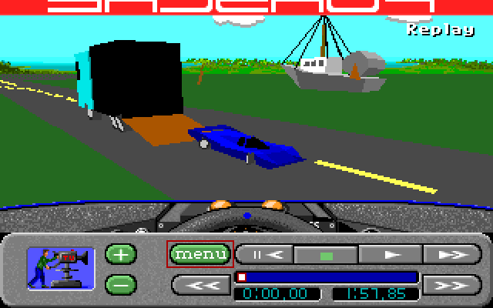
Stunts 1990
15 years old but:
a lot of fun!
realtime 3D graphics
integrated map editor
nice artificial intelligence
interactive replay with several cameras

Slide 7
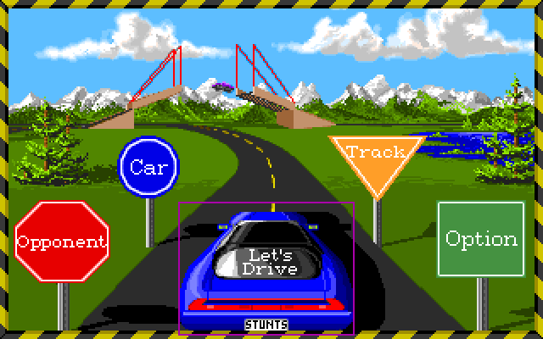
Stunts 2005
not just a remake as our aims are:
doing a new game on the old model with
state of the art graphics (Mode X -> hw shader)
more realistic sounds (PC speaker -> Surround)
extended control input (keyb. -> steering wheel)
flexible game engine (multiplayer, career mode ?)

Slide 8
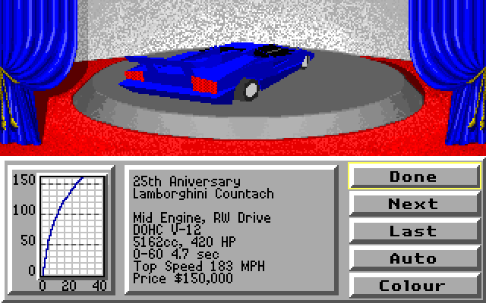
Stunts 2005
capabilities:
set of different cars (deformable meshes)

Slide 9
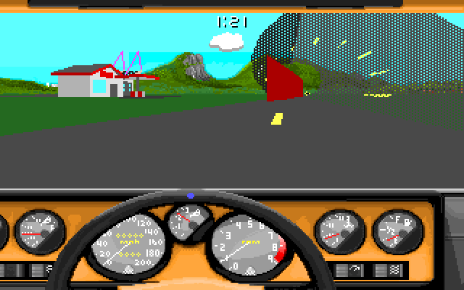
Stunts 2005
capabilities:
set of different cars (deformable meshes)
set of various obstacles (loopings, bridges, etc.)

Slide 10
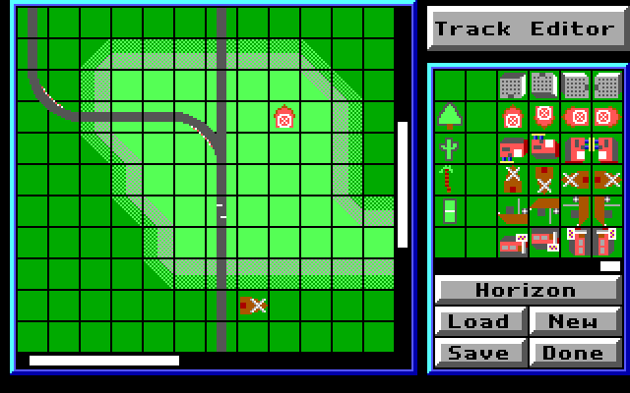
Stunts 2005
capabilities:
set of different cars (deformable meshes)
set of various obstacles (loopings, bridges, etc.)
map editor (objects will have sounds and effects)

Slide 11
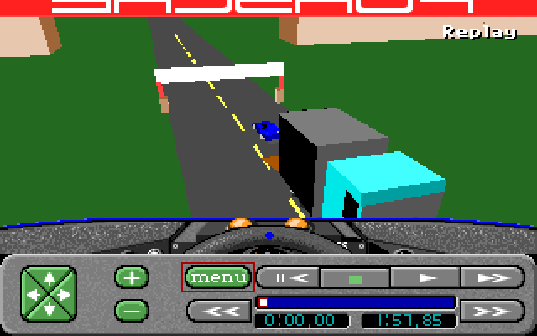
Stunts 2005
capabilities:
set of different cars (deformable meshes)
set of various obstacles (loopings, bridges, etc.)
map editor (objects will have sounds and effects)
video recorder

Slide 12
Stunts 2005
extras:
day/night simulation
lively (organic) environment
interactive sound scenery

Slide 13
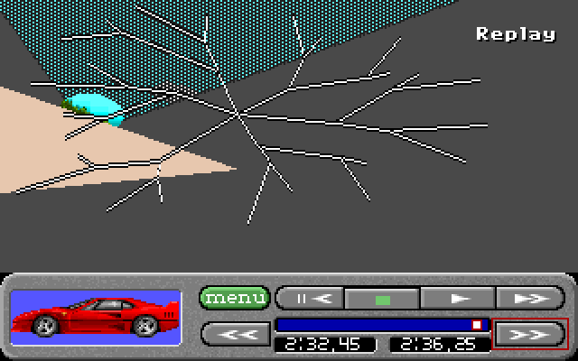
Stunts 2005
Thank you!

